Slide 1

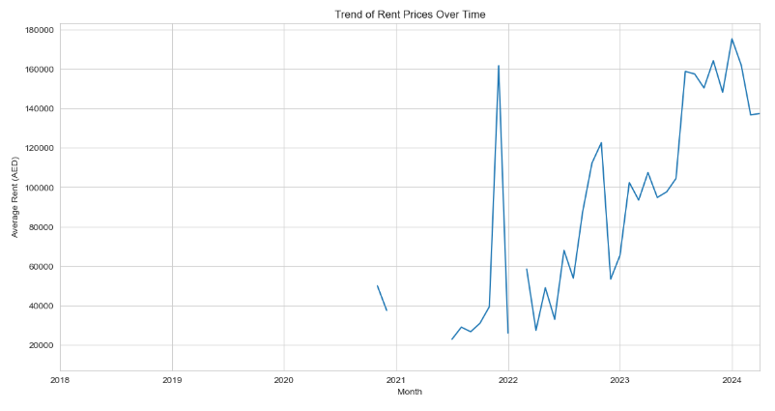
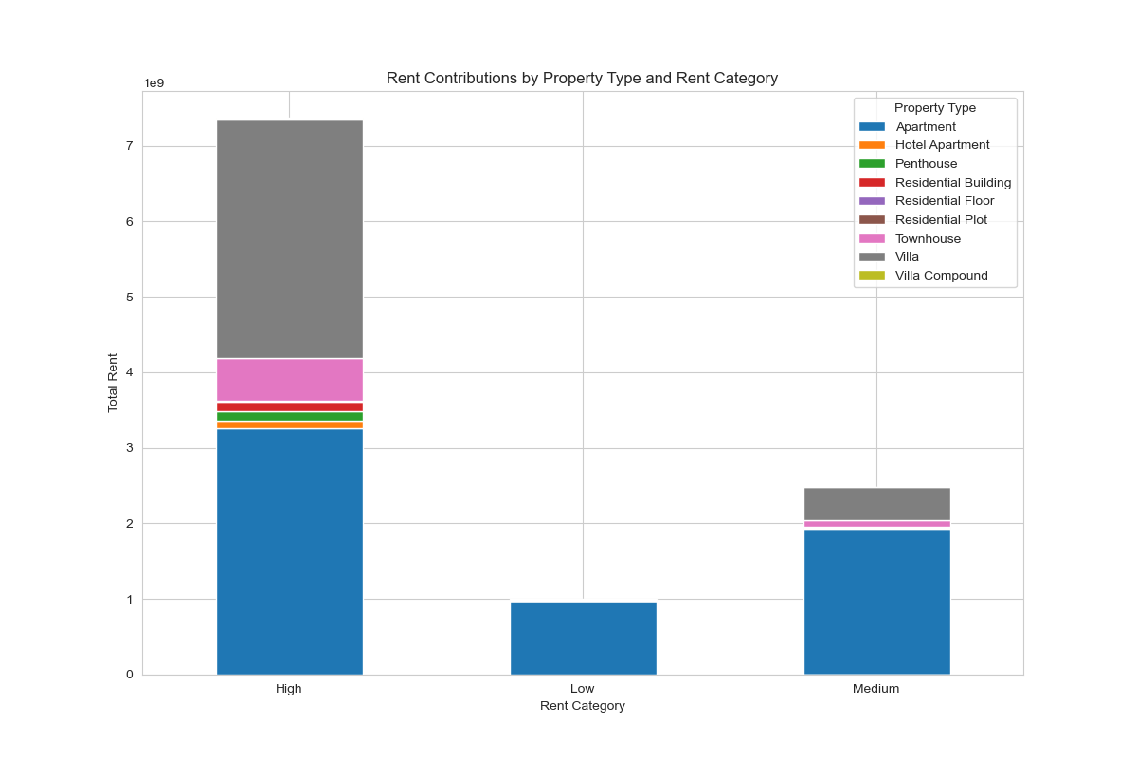
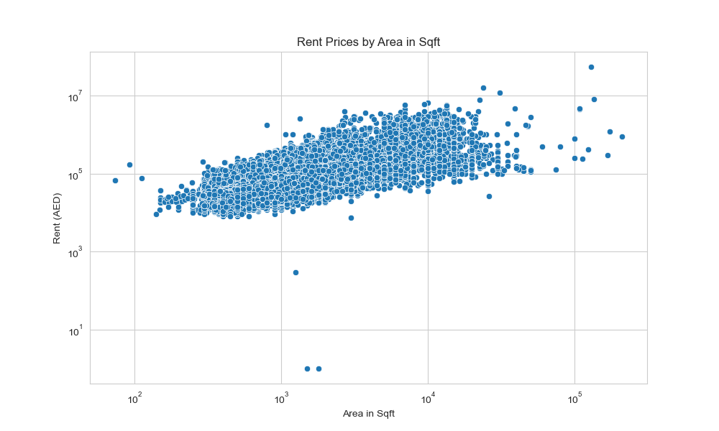
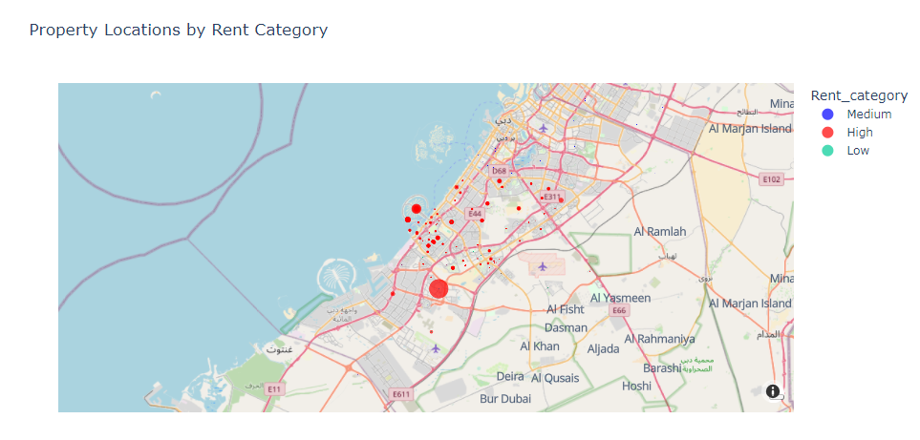
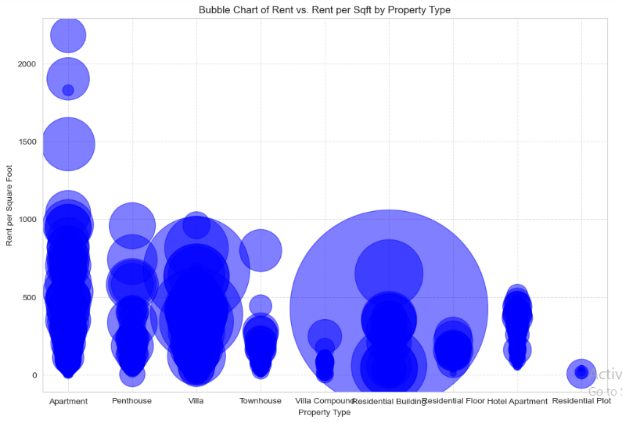
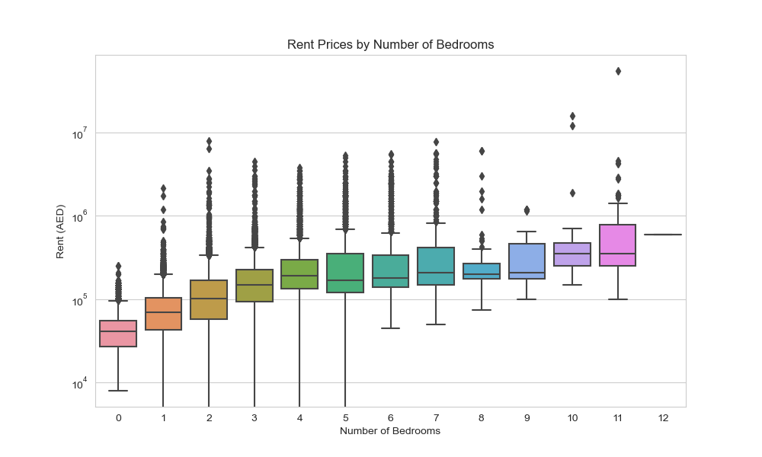
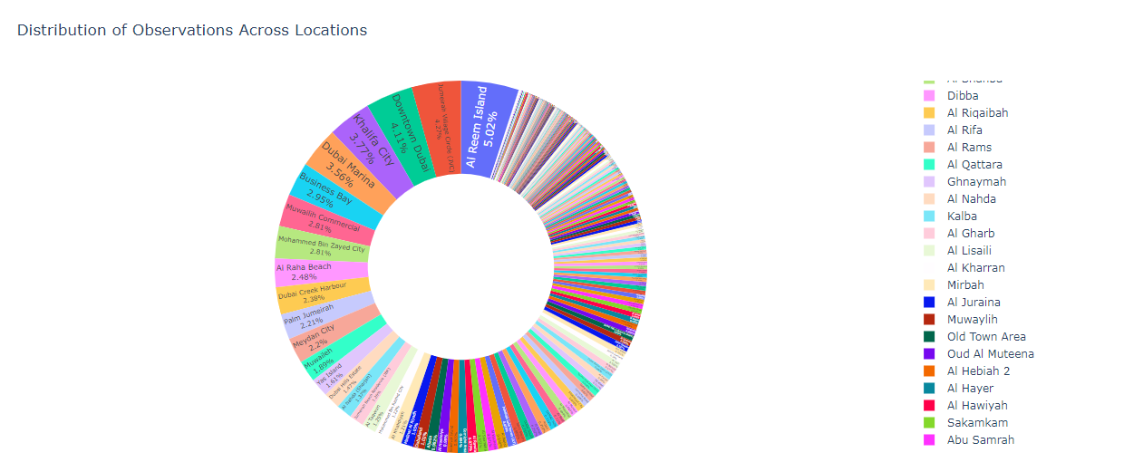
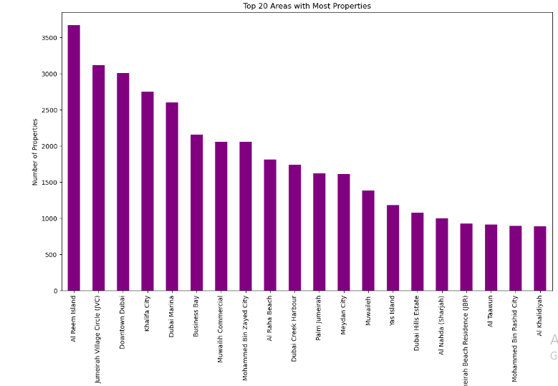
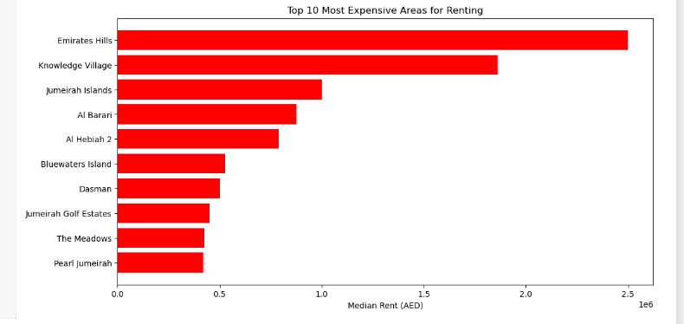
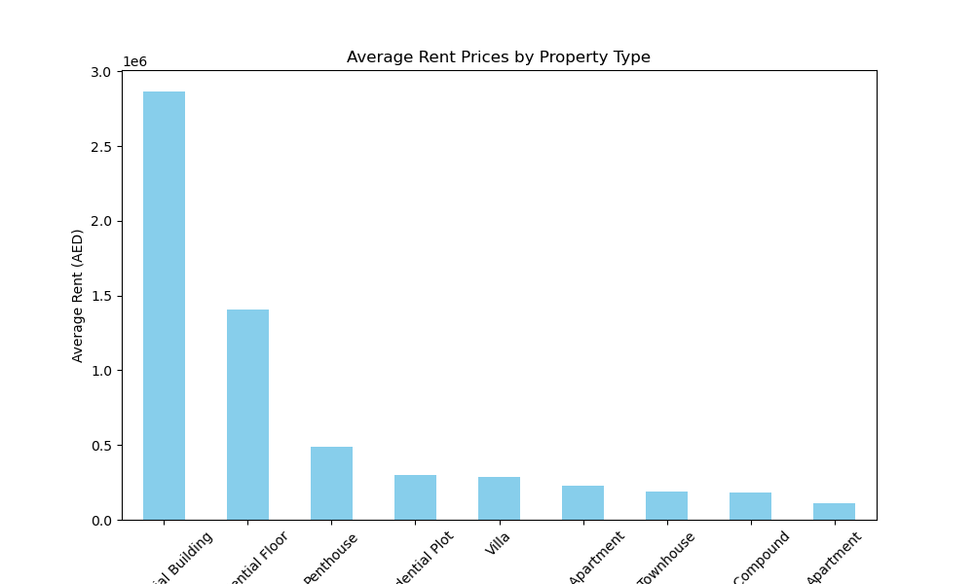
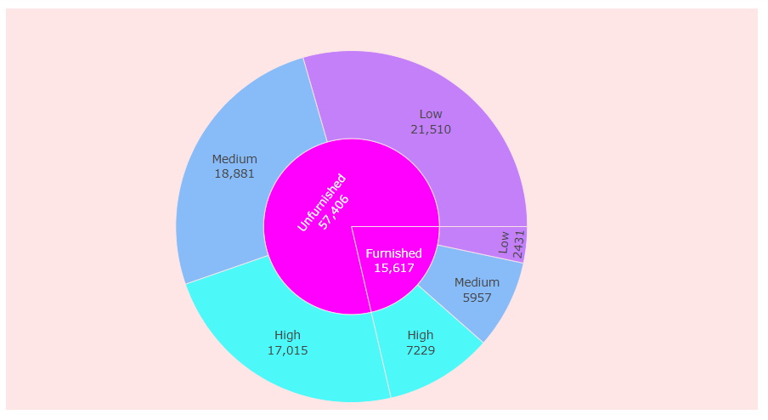

Data Visualization Module
Poster Presentation on Dubai, UAE Rental Properties Dataset
INSERT LOGO HERE
Prepared by: Student ID_230233928
Introduction
Visualizations
The dataset is about Abu Dhabi rental properties.
The dataset includes details on a range of Abu Dhabi rental properties, such as villas, apartments, and penthouses.
Rent, the number of bedrooms and bathrooms, the type of property, the area, the rent per square foot, the rent category, and other details like the purpose, the furnishing status, the posted date, the location, and the geographic coordinates are all included in this dataset.
Data Source
- The dataset downloaded from kaggle and selected dataset contains 73742 rows and 17 columns.
- For further details about the dataset and its license directly get from the URL https://www.kaggle.com/datasets/azharsaleem/real-estate-goldmine-dubai-uae-rental-market
​
Conclusion
Methodology
The series of visualizations on the property listing data gave insight into the real estate market relevant to Abu Dhabi.
It indicates how rent is distributed in different types of properties for example, how different price strategies are applied to apartments, penthouses, and villas.
Mapping of properties also involves showing the geographic trends and categories of the place with rents, which appear to help in visualizing how the rental prices differ within different places and for different types of properties.
The scatter plot of rent against area provides a good, clear insight into how the size of property is related to the rent charge, which is very important for prospective tenants and analysts of real estate.
Thereby, the timeline of property listings gave a general description of market dynamics over time and pointed out periods with increased or decreased activity.
- Data Selection
- Data cleaning and preprocessing
- Data visualization
This poster presentation was created by 230233928
Notes:
You can add your presentation notes here. This presentation template for research posters is fully editable so text, graphics and content can be updated to fit your own research needs.
Download more poster presentation templates from FPPT.com

